Slide 1
Unit testing
Gary Bowerbank, Csaba Riedlinger

Slide 2
Contents
Unit testing, examples
Recommended format, content
Briefly on integration-, system-, stress-, regression testing
Helper scripts
Storage options

Slide 3
A good unit test is
Can be run in any order if part of many other tests
Runs fast
Tests a single logical concept in the system
Readable
Maintainable
Trustworthy

Slide 4
A good unit test is
Can be run in any order if part of many other tests
Runs fast
Tests a single logical concept in the system
Readable
Maintainable
Trustworthy
About “A robust way of designing software components interactively so that their behaviour is specified through unit tests”

Slide 5
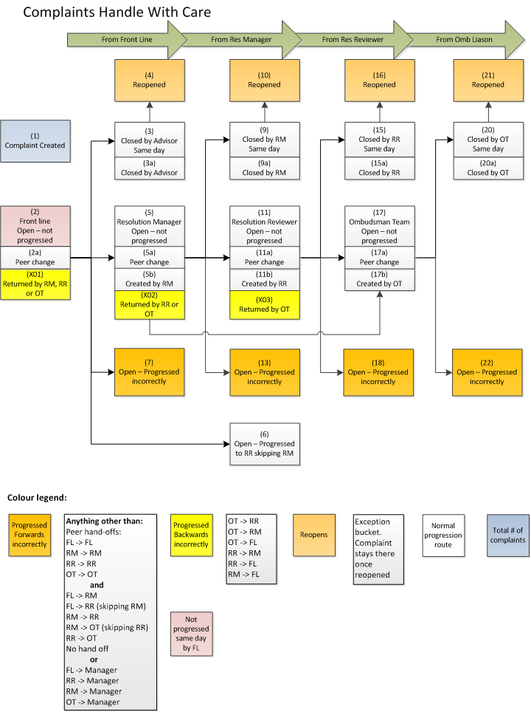
HWC

Slide 6
Unit test examples
What is a unit?
Individual units of source code
Isolated code fragments
Smallest testable piece of an application
Sub-query factoring (Ex1)
Smaller or bigger units? (Ex11, Ex12)

Slide 7
Unit test examples
What is a unit?
Individual units of source code
Isolated code fragments
Smallest testable piece of an application
Sub-query factoring (Ex1)
Smaller or bigger units? (Ex11, Ex12)
Test data
Select from
DUAL
HDS
Source table (Ex2)
Mock up table (Ex3)

Slide 8
Recommended format, content
Unit test file (view_name.ut.sql) – single vs. multiple files (Ex4)
Header – similar to view/procedure/package
Created when, by who, what purpose, modified by, change history

Slide 9
Recommended format, content
Unit test file (view_name.ut.sql) – single vs. multiple files (Ex4)
Header – similar to view/procedure/package
Created when, by who, what purpose, modified by, change history
Test data setup section
Scenarios, supporting columns,
Expected results, outcomes (PL/SQL wrapper?) (Ex5)

Slide 10
Recommended format, content
Unit test file (view_name.ut.sql) – single vs. multiple files (Ex4)
Header – similar to view/procedure/package
Created when, by who, what purpose, modified by, change history
Test data setup section
Scenarios, supporting columns,
Expected results, outcomes (PL/SQL wrapper?) (Ex5)
Clear down test data, then
repeat with real data
repeat with garbage data (we can’t cater for all cases)

Slide 11
Recommended format, content
Unit test file (view_name.ut.sql) – single vs. multiple files (Ex4)
Header – similar to view/procedure/package
Created when, by who, what purpose, modified by, change history
Test data setup section
Scenarios, supporting columns,
Expected results, outcomes (PL/SQL wrapper?) (Ex5)
Clear down test data, then
repeat with real data
repeat with garbage data (we can’t cater for all cases)
Unit test log (view_name.ut.log) (Ex4)
When, who, what
Normal scenarios and exceptions
Duplicate testing
Incremental updates, multi-day runs
Explain plan

Slide 12
Recommended format, summary
Create unit test file
Setup test data
Log outcomes against expected results
Check performance is necessary
Clear down test data
Repeat test with real data
Repeat with garbage data

Slide 13
Integration-, system-, stress-, regression testing
Integration test: individual modules/units combined and tested as a group
Check whether all components interact correctly (Ex5)

Slide 14
Integration-, system-, stress-, regression testing
Integration test: individual modules/units combined and tested as a group
Check whether all components interact correctly (Ex5)
System test: black box testing conducted on a complete system
To evaluate the system’s compliance with the requirements

Slide 15
Integration-, system-, stress-, regression testing
Integration test: individual modules/units combined and tested as a group
Check whether all components interact correctly (Ex5)
System test: black box testing conducted on a complete system
To evaluate the system’s compliance with the requirements
Stress testing: emphasis on robustness, availability and responsiveness under heavy load

Slide 16
Integration-, system-, stress-, regression testing
Integration test: individual modules/units combined and tested as a group
Check whether all components interact correctly (Ex5)
System test: black box testing conducted on a complete system
To evaluate the system’s compliance with the requirements
Stress testing: emphasis on robustness, availability and responsiveness under heavy load
Regression testing: aims to uncover bugs in existing systems after changes (enhancements, patches, configuration change, etc.)

Slide 17
Helper scripts
Helps you with design related decisions
Examples:
Test data generator
Analytical functions’ use
Hierarchical queries
Model clause
Pivot – unpivot
Stitched query
Regular expressions
The truth matrix
NOT IN – clause
MERGE techniques

Slide 18
Storage options
Shared drive
Same structure as Dimensions
Final code, unit test and log file kept together
Separate sub-directories may be used for test data, mock-up objects, finalised code
Database
Stored in a CLOB
Maintained by an APEX app

Slide 19
Storage options
Dimensions
Use structure implemented for Test Driven Development (TDD)
Folder can be set up by DBAs as required
Separate folder for test data scripts, logs, results, packages etc.
Option to have another thread for third party apps (e.g. PLUNIT)

Slide 20
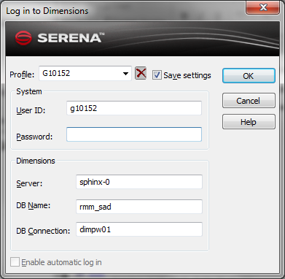
Screenshots

Slide 21
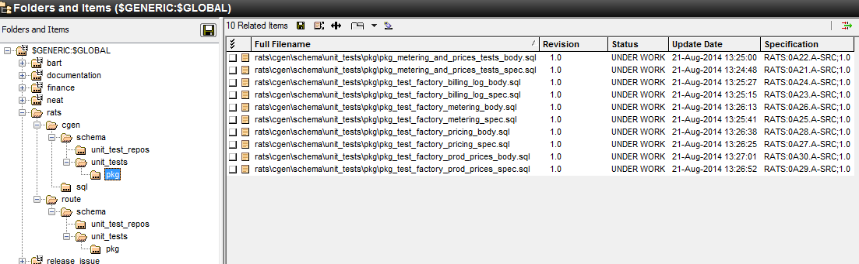
Screenshots

Slide 22
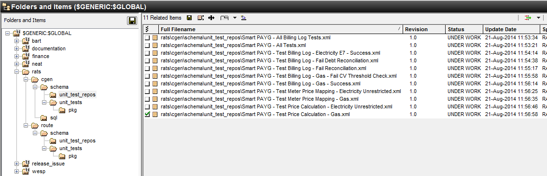
Screenshots

